Slide 1
What is a Theory?
Imran A. Sajid, PhD
Lecturer
University of Peshawar
imranahmad131@uop.edu.pk

Slide 2
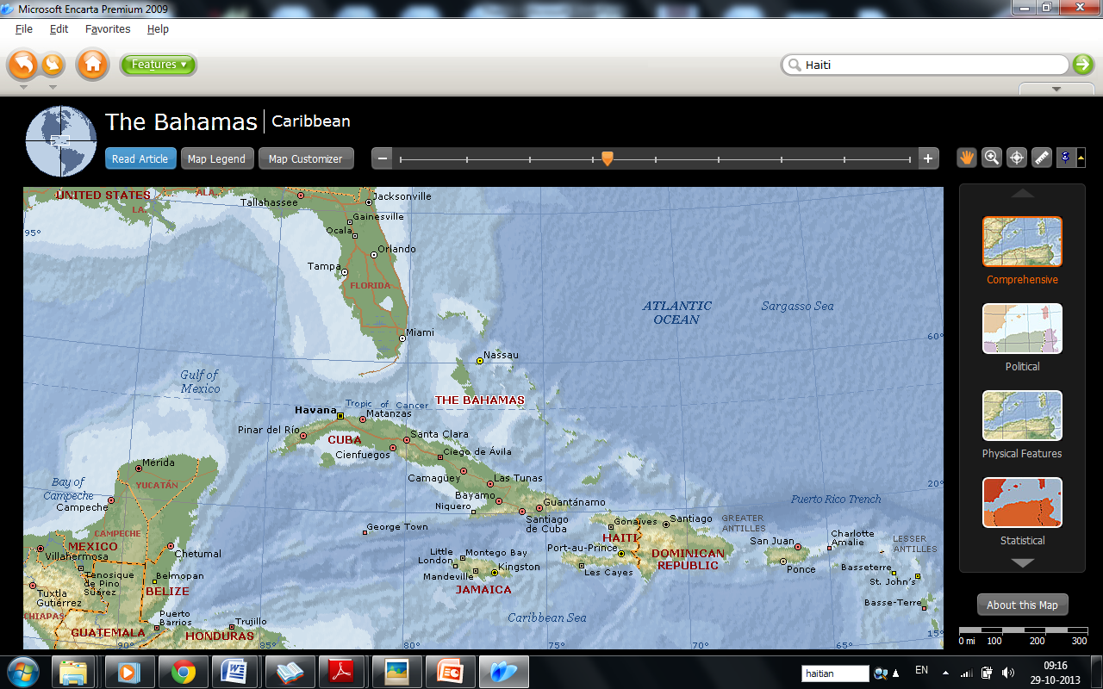

Slide 3
Abner Louima – a 30 year old male Haitian immigrant – New York City Police station
Kitty Gen – New York 1960 –48 neighbours heard scream
Puzzle –
How so many people could stand by without coming to the aid of the victims?

Slide 4
Bibb Lantane and John Darley
Theory of diffused responsibility
The greater the number of bystanders or witnesses to an event that calls for helping behaviour, the more the responsibility for helping is perceived to be shared by all the bystanders.
Because of this sense of shared responsibility, then the more people present in an emergency situation, the less personally responsible each person feels---and the less likely it is that any single person will come forward to help.

Slide 5
Definitions
Theories are nets cast to catch what we call ‘the world’: to rationalize, to explain, and to master it. We endeavour to make the mesh finer and finer (Popper, 1959).
Theory is a ‘story’ about how and why events in the universe occur (Turner, 1991).
Theory is a model of reality appropriate to a particular discipline. Such a model helps us to understand what is, what is possible, and how to achieve the possible (Turner, 1995).

Slide 6
Essential Elements of a Theory
Concepts
Facts
Hypothesis
Principles

Slide 7
CONCEPTS

Slide 8
1. Concepts
Concepts are building blocks of theory.
Concepts are abstractions representing logical descriptions of reality that a discipline develops to describe the phenomena with which it is dealing.
Concepts are thus the labels by which we communicate with others within a discipline.
They are greed-upon terms that describe our practice world.
A concept is not a phenomenon (something experienced; a fact) but a formulation about a phenomenon that is derived from abstractions based on our experiences.

Slide 9
Some concepts in social work practice are
Rapport
Relationship
Personality strengths
Empowerment
Juvenile Delinquency
Coping
Crisis
Self-identity
Defence mechanism

Slide 10
Meanings of a Concept
Scientific
Non-Scientific

Slide 11
Example
Concept | Non-Scientific Meaning | Scientific Meaning
Mass | Big pile of something | Quality of matter that can be measured by certain operations
Function | Any kind of activity | Purpose, object, role
Juvenile | Youthful/not yet mature | Youthful/not yet mature
State | Country | a country's government and those government-controlled institutions that are responsible for its internal administration and its relationships with other countries
War | Fight between countries | a period of hostile relations between countries, states, or factions that leads to fighting between armed forces, especially in land, air, or sea battles

Slide 12
Types of Concept
To simplify, concepts are of two types
1. Variable Concepts
A v.c is a concept that varies.
Expresses value, intensity, quantity, amount
Example: income, temperature, density of population, years of schooling, degree of violence
2. Non-variable concepts
Express categories: example, bureaucracy, family, college degree, cold, terrorism

Slide 13
Scope of a Concept
Concepts vary as to scope.
Narrow
Broad
Broad concepts are more abstract than narrow concepts

Slide 14
1. Narrow:
Apply only to specific social settings
Are restricted in time or place
Example:
football hooliganism: Violence by British and, to a degree, other European soccer fans that have accelerated since the late 1960s.

Slide 15
2. Broad:
Apply to many diverse settings or activities across large expanses of time and space.
Example: Emotional warmth, happiness, freedom, aggression

Slide 16
FACTS

Slide 17
Facts
Facts are concepts that can be empirically verified, that is, they are testable observations related to the concepts with which we deal.
Theory emerges from the process of ordering facts in a meaningful way.
That is, a certain relationship between facts is posited through observation or through deduction, induction, speculation, inspiration, or experience and then subjected to testing.
%age of budget spent on welfare
Peace index
Notes:
What constitutes adequate empirical evidence for a concept to be a fact is an involved and challenging issue.
The history of the search for knowledge over the centuries is replete with examples of accepted ‘facts’ subsequently supplanted by other facts.

Slide 18
Hypothesis

Slide 19
These relationships between facts are described in statements called hypotheses, which are tested for accuracy through the methods of disciplined observation employed in the varied processes of research.
When a hypothesis has been found to be supported, the theory can be said to have advanced a step.

Slide 20
Relationships are connections b/w facts
A theory is more than just a bundle of concepts and assumptions; a social science theory also specifies relationships among the concepts (Lawrence Neuman)
A Theory tells us whether the concepts are connected to one another, and if so, how.

Slide 21
Kinds of Relationships
‘a’<----->’b’
‘a’<- - - - >’b’
Strong v Weak
Positive v Negative
Direct v Indirect
Concept ‘A’
Direct
Concept ‘B’
Direct
Concept ‘C’
Indirect

Slide 22
It might tell us
Kinds of Relationships
2
Whether one concept Accelerate or diminishes other
Whether its Impact is Immediate or delayed
Whether one concept is Necessary Precondition for another concept or sufficient
Necessary (essential and required)
Sufficient (it is involved but does not have to be present)

Slide 23
Proposition and Hypothesis

Slide 24
PROPOSITION
Propositions assert relationships (Martin A. Kozloff).
Relationships among what?
The answer is, relationships among concepts.

Slide 25
Propositions are the bones of a theory (Martin A. Kozloff).
A proposition is a theoretical statement that two or more factors or concepts are related and the type of relationship it is.
It is a belief that may or may not have been tested.

Slide 26
Examples of propositions include the following.
1. "The larger the percentage of a country's GNP is spent on the military, the higher is its rate of infant mortality."
[This is a hypothetical proposition asserting a direct relationship that operates in one direction--unilaterally.]

Slide 27
2. "The greater the strength of social networks the better is the health of its members."
[This is a hypothetical proposition asserting a direct relationship that could be bi-directional or reciprocal.]
Strength of Social Networks = ("strength" operationalized, for example, by the number of people in networks and how often members of a network interact with one another),

Slide 28
Proposition assert relationships among concepts
3. "The stronger the social integration in a community the lower is the rate of suicide, alcoholism, and juvenile crime."
[This is a hypothetical proposition asserting an indirect or inverse relationship that might be reciprocal.]
Notes:
Social Integration in Community = (operationalized, for instance, by the percentage of eligible voters who vote, the percentage of families that attend some kind of church services on a regular basis, the percentage of eligible or relevant persons who attend PTA meetings, the average number of neighbors whom persons can name),

Slide 29
Categorical and Hypothetical Relationships
Propositions generally assert two kinds of relationships:
Categorical, and
Hypothetical

Slide 30
Categorical Propositions
Categorical propositions assert that all (or part) of one class/category is included in or is excluded from another class.
Examples
1. "All humans are mortal."
[This categorical proposition asserts that one category is completely within another category.]

Slide 31
2. "Most suicidal persons have clinical depression."
[This categorical proposition asserts that part of one category is within another category.]

Slide 32
Categorical propositions assert that all (or part) of one class is included in or is excluded from another class.
3. "No form of social organization is permanent."
[This proposition asserts that none of one category in in the other category.]

Slide 33
Hypothetical Propositions or Hypothesis
Hypothetical Propositions are known as Hypothesis.
Aka as functional propositions, or causal propositions.
A Hypothesis is an empirically testable version of a proposition (Lawrence Neuman).

Slide 34
Hypothetical Propositions
It shows relationship between two or more variable concepts.
Examples:
1. "The more stressors that bear upon people during a year, the more illnesses they will have during that year."
direct relationship between stressors and illness;
If “a” increases, “b” also increases.

Slide 35
2. "The more interpersonal support persons have for their moral principles, the less likely they are to obey orders which prescribe what they consider immoral acts.”
inverse (or indirect) relationship between interpersonal support and obedience.
If “a” increases, “b” decreases, and vice versa.

Slide 36
Types of Hypothesis based on Statement
Null hypotheses (no relationship between two variables).
Non-directional hypotheses (we don’t know or won’t speculate about the direction of the relationship between two variables).
Directional hypotheses. We state the direction of the relationship between two variables.

Slide 37
Examples of hypothesis type:
Null: There will be no difference in scores on Rosenberg's Self-esteem Scale between men and women.
Directional: Women will have higher scores than men on Rosenberg's Self-esteem Scale.
Nondirectional: There will be a difference by gender in Rosenberg's Self-esteem Scale scores.
Name of a test designed by Rosenberg for calculating Self-Esteem

Slide 38
Rosenberg’s Self-Esteem Test
confidence in your own merit as an individual person.
S# |  | Score
1 | I feel that I am a person of worth, at least on an equal basis with others.
2 | I feel that I have a number of good qualities.
3 | All in all, I am inclined to think I am a failure.
4 | I am able to do things as well as most other people.
5 | I feel I do not have much to be proud of.
6 | I take a positive attitude toward myself.
7 | On the whole, I am satisfied with myself.
8 | I wish I could have more respect for myself.
9 | I certainly feel useless at times.
10 | At times I think I am no good at all.
Score Code
Strongly Disagree | 1
Moderately Disagree | 2
Neither A nor D | 3
Moderately Agree | 4
Strongly Agree | 5
Notes:
http://zimmer.csufresno.edu/~donnah/code%20book.htm

Slide 39
Items 3, 5, 8, 9, and 10 are scored in reverse (i.e. 5 = 1, 4 = 2, 3=3, 2=4, 1=5)
SES score can range from 10 to 50
Notes:
A score of 30 is the mid-point, neither low nor high self-esteem

Slide 40
VARIABLES
A variable is a concept that varies.
Mostly used in quantitative research.
A variable must have at least two values known as attributes.

Slide 41
Examples of Variable and Values
Gender = Male / Female
Marital Status = Never Married, Single, Married, Divorced, Widowed
Types of Crime = robbery, burglary, murder, theft,
Family income = 0 , 1000, 50T, 1 L, 1B
Attitude towards female education = Strongly favour/ Strongly oppose etc

Slide 42
Attributes
assign qualities to somebody or something
A variable’s values or categories are it’s attributes.
Variables and Attributes are easily confused

Slide 43
Types of Variables
Independent Variable
Dependent Variable
‘Intervening Variable’
Example:
IF WE CONTINUE TO BURN RISING AMOUNTS OF OIL THEN THE WORLD’S TEMPERATURE WILL RISE
–INDEPENDENT VARIABLE -BURNING FUEL
–DEPENDENT VARIABLE -GLOBAL CLIMATE
Examples
Marital Status
Suicide Rate
Social Integration
Emile Durkheim

Slide 44
1. Independent Variable
The cause variable is the independent variable. Or
The force or condition that acts on something else is an independent variable.
For example:
Married people are less likely to commit suicide than single people (Emile Durkheim)

Slide 45
2. Dependent Variable
The variable that is the effect, result, or outcome of another variable is the dependent variable.
For example:
Married people are less likely to commit suicide than single people (Emile Durkheim)
Simple Example:
“If I praise you, you will probably feel good, but if I am critical of you, you will probably feel angry.”
My response to you is the independent variable, and your response to me is the dependent variable, because what I say influences how you respond.

Slide 46
3. Intervening Variable
Causal mechanism
Coming between independent and dependent variable, this variable helps to show the link or mechanism between them.
For example:
Married people are less likely to commit suicide than single people (Emile Durkheim)
Married people have more social integration (i.e. feelings of belonging to a group/family).
A major cause of one type of suicide was that people lacked a sense of belonging to a group.

Slide 47
PRINCIPLES

Slide 48
Principles are statements about fundamental laws or rules that emerge from tested hypotheses.
They become the bases on which theory-based action is taken.
In social work practice, the statement from systems theory that a change in one part of a system results in change in the entire system would be an example of theory-based principles.

Slide 49
We can never say when a theory is fully developed.
Development of a theory in any discipline is an on-going process.

